Slide 1
Q-learning based Navigation System for Large E-Commerce Warehouse Ground Robots
Md. Sazidur Rahman (17201089)
Md. Jisan Bin Islam (17201090)

Slide 2
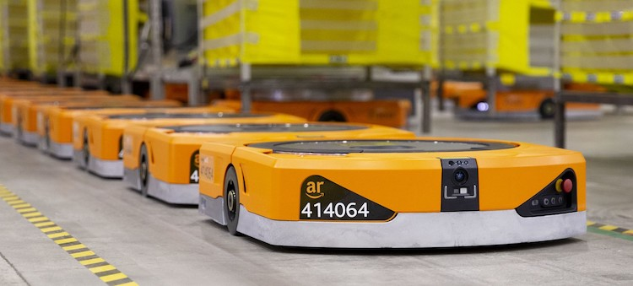
Introduction
Reinforcement Learning
History of autonomous industrial robots
Proposed Model
Contribution

Slide 3
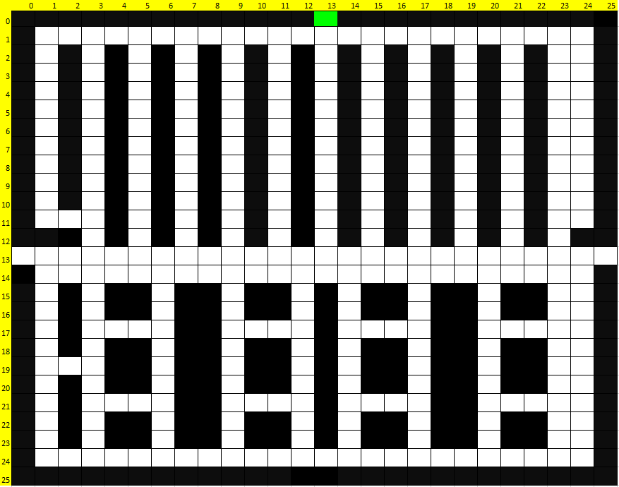
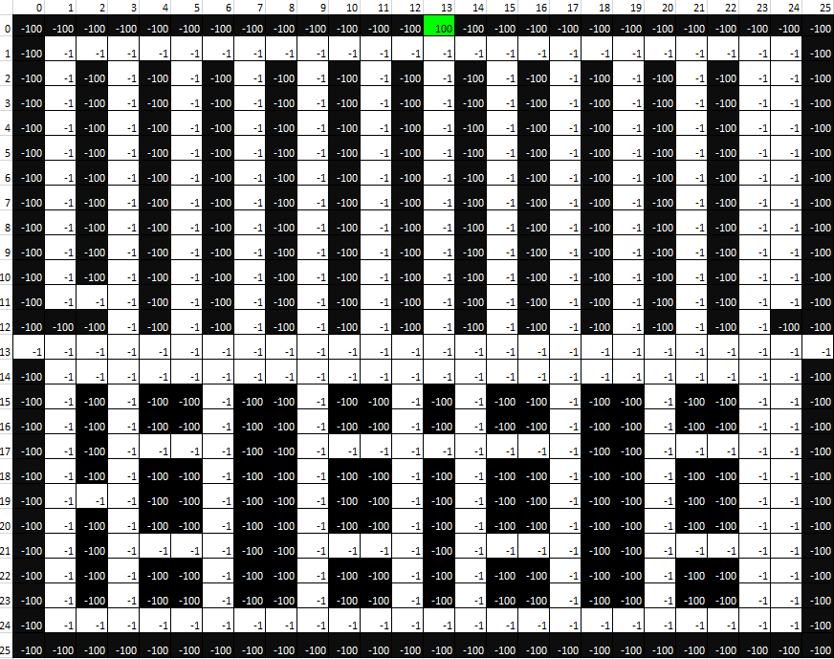
Methodology
System Representation
Environment
State
Action
Reward

Slide 4
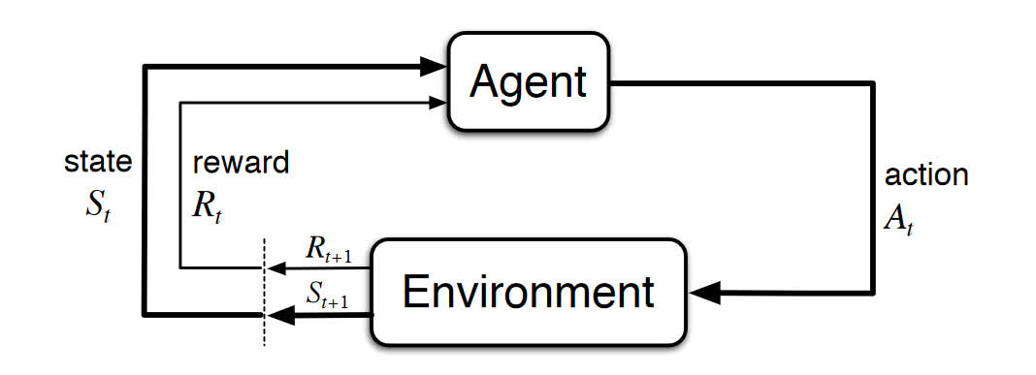
Q-Learning Method
Markov Decision Process
Q-learning Objectives
Storing Q values in Q-table

Slide 5
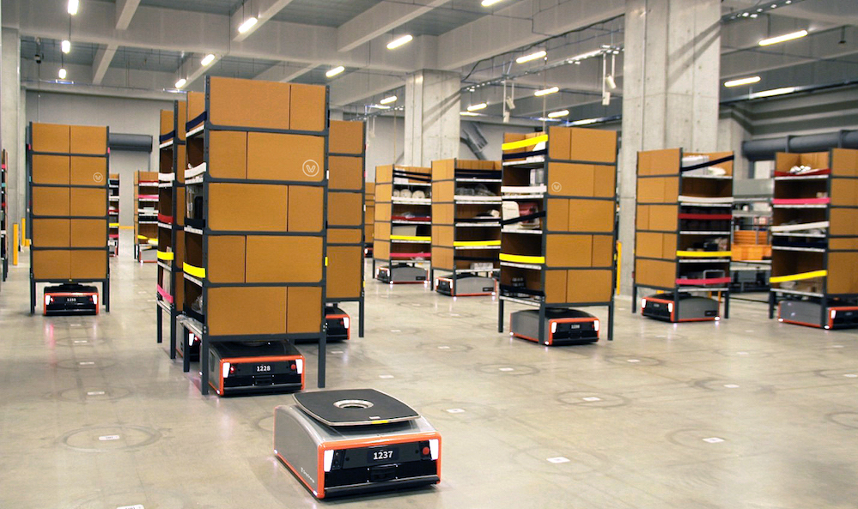
Implementation Details & Novelty of this project
Algorithm
Low time complexity
Efficient
Adaptive to any environment
Shortest path

Slide 6
Conclusion & Future Work
Adding autonomous charging feature in future
Increase use of this method in other places rather than warehouses like restaurants, offices, household etc.

Slide 7
Thank You

